Slide 1

A PROJECT EXPLORING MEDICARE PART D NEGOTIATION PROGRAM

Slide 2

AGENDA
What is Medicare and its Negotiation Program?
Selecting a drug for the program
Exploratory Data Analysis
Approach to forecasting and Selection
Conclusion

Slide 3
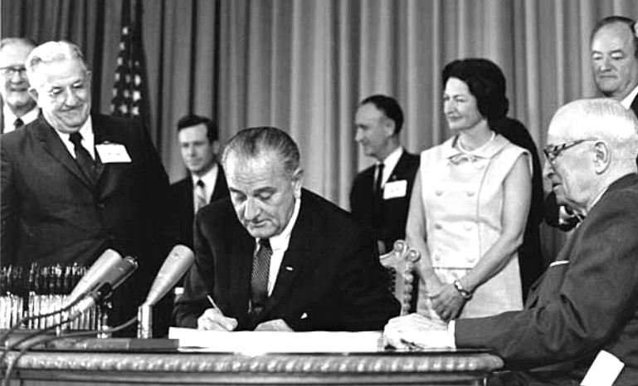
What is Medicare?

Slide 4
A few facts about Medicare
What’s included?
What is it?
Covers half of healthcare expenses
Generally complimented by private insurance
Four parts:
Part A – Hospital services
Part B – Outpatient services
Part C – Alternative
Part D – Self-administered prescription drugs
Origins
Federal health insurance program
Older than 65 or younger disabled people
In 2022, 65 millions insured
$900 billions spent by Medicare trustees
Enacted in 1965 under Pres. Lyndon Johnson
Begun under Social Security Administration
Pres. Harry Truman and wife – first recipients

Slide 5
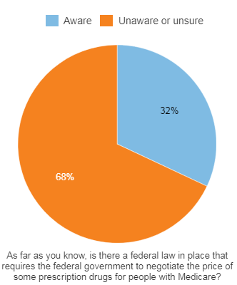
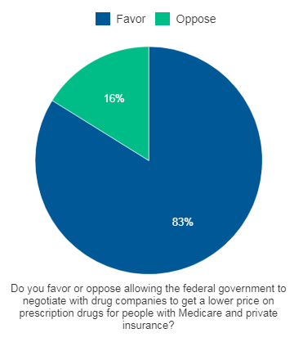
Medicare Part D Negotiation Program
Part of Inflation Reduction Act
Able to negotiate directly with drug companies
Improve drug affordability
Maximum Fair Price introduced
Selected 10 drugs for 2026
Adding 5 every year, 20 in 2029

Slide 6
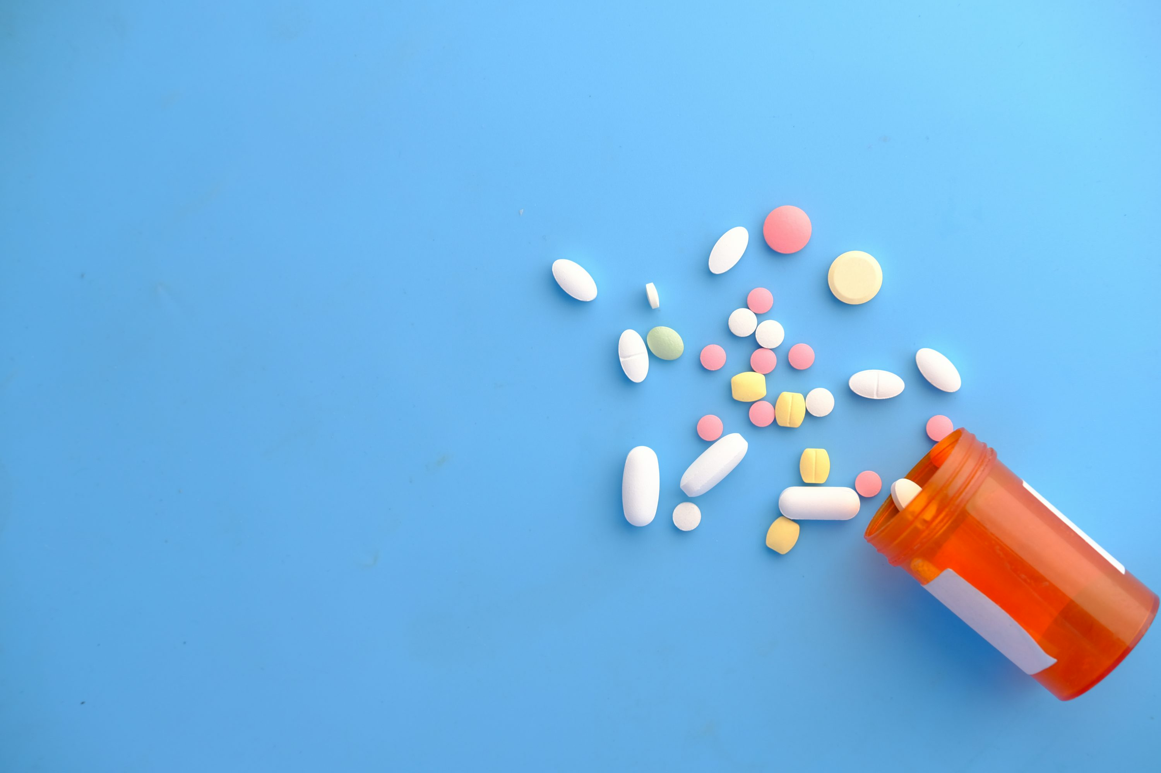
Which drug to choose?

Slide 7
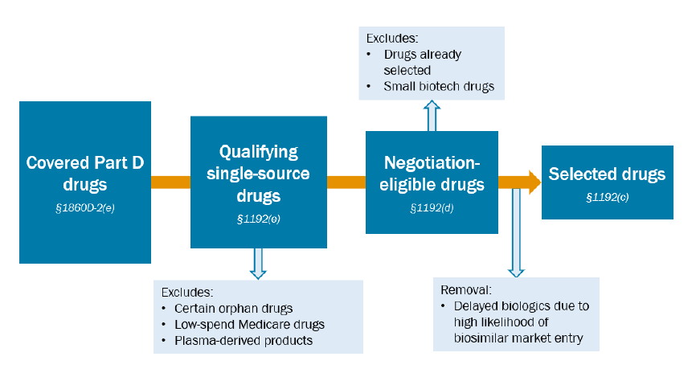
Selecting Drugs for Negotiation
Must be single source
Licensed under FD&C Act
7 years elapsed since the date of approval
Not under ANDA
Different requirements for biological products
Drug Selection process for 2027

Slide 8
Medicare Part D Spending by Drug Dataset
11 years of data i.e. 2012 to 2022
Derived from PDE records
Info about manufacturers included
Drug use and clinical indications
Summarized by linking NDCs
Around 4.7K drugs in total
 | Total Spending | Total Claims | Total Beneficiaries | Total Dosage Units | Average Spending Per Dosage Unit | Average Spending Per Claim | Average Spending Per Beneficiary
Mean | 50788292 | 326219 | 94336 | 25288185 | 373 | 2598 | 12534
STD | 347809204 | 2164783 | 574664 | 181158952 | 4281 | 10873 | 60902
min | 0 | 0 | 0 | 0 | 0 | 0 | 0
25% | 339 | 12 | 0 | 49 | 0 | 6 | 0
50% | 393057 | 743 | 224 | 32013 | 2 | 112 | 223
75% | 10334685 | 17522 | 4761 | 912387 | 22 | 826 | 2715
max | 15219812294 | 64797302 | 15885735 | 4654341154 | 233364 | 323721 | 1595175
Data Table for year 2022

Slide 9

Exploratory Data Analysis

Slide 10
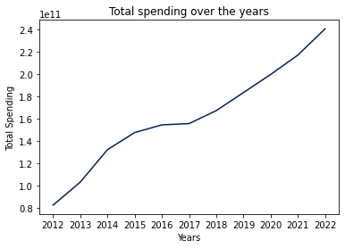
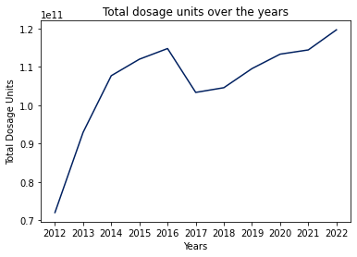
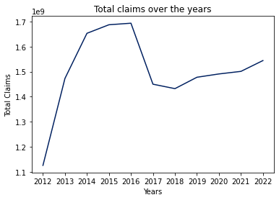
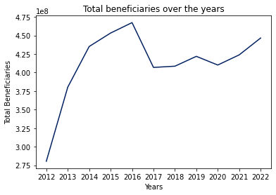
General trends
Combined data over 11 years
Increasing trend in general
Spending trend unaffected, others dipped in 2016-2017
Increase in price per unit?
Averaged features follow spending trend

Slide 11
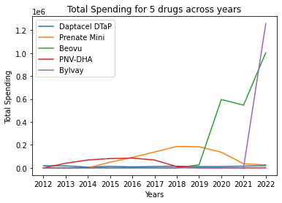
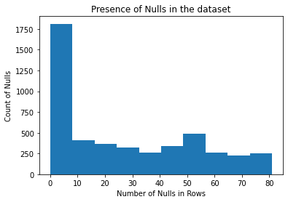
A walk through the data
Each drug performance looks independent
Combined dataset – 88 features
Presence of nulls
Leading – Removed
Trailing – Imputed with zeros
In between – Removed

Slide 12
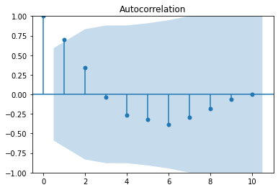
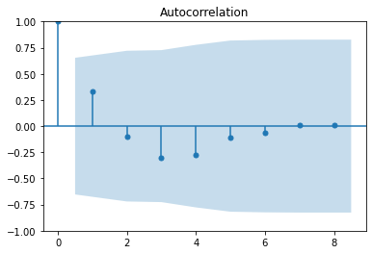
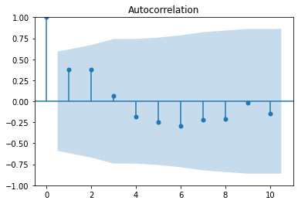
Stationarity and Autocorrelation
Assumption: Most series weren’t stationary
ADF test
Null Hypothesis – Presence of unit root – Not stationary
1255 points (29.87% of data) stationary
Additional 2070 (49%) stationary after differencing (<4)
Assumption: Majority should be autocorrelated
Visual Inspection – ACF plots
ACF value (threshold 0.80) – 75 points (1.7%)

Slide 13
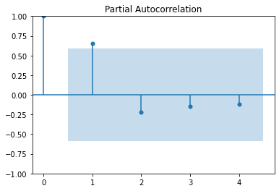
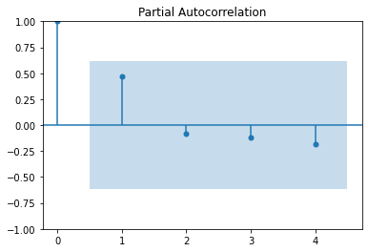
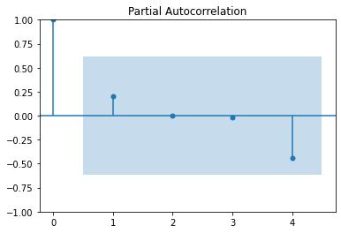
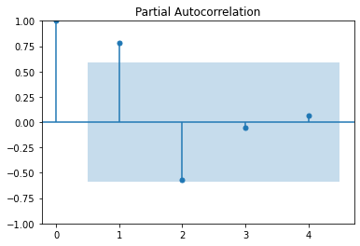
Trend and Seasonality?
Very few datapoints per time series
For trend, Mann Kendall Trend Test
Hamed and Rao Modified
Needed atleast 4 points
954 points excluded
Trend exists for half the data
Yearly aggregated data
PACF plot, 603 points (14.35%) with significant lags
Visually inspected sample
Seasonality didn’t exist for most
 | Count | Percentage of Data
Increasing | 913 | 24.15%
No Trend | 1956 | 51.74%
Decreasing | 911 | 24.10%

Slide 14

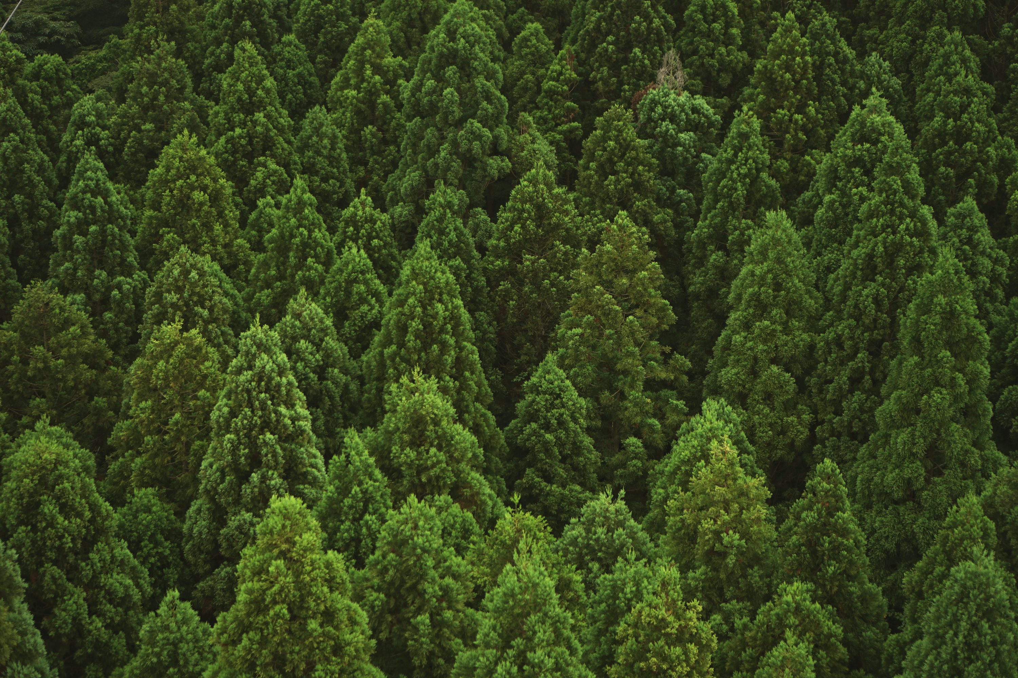
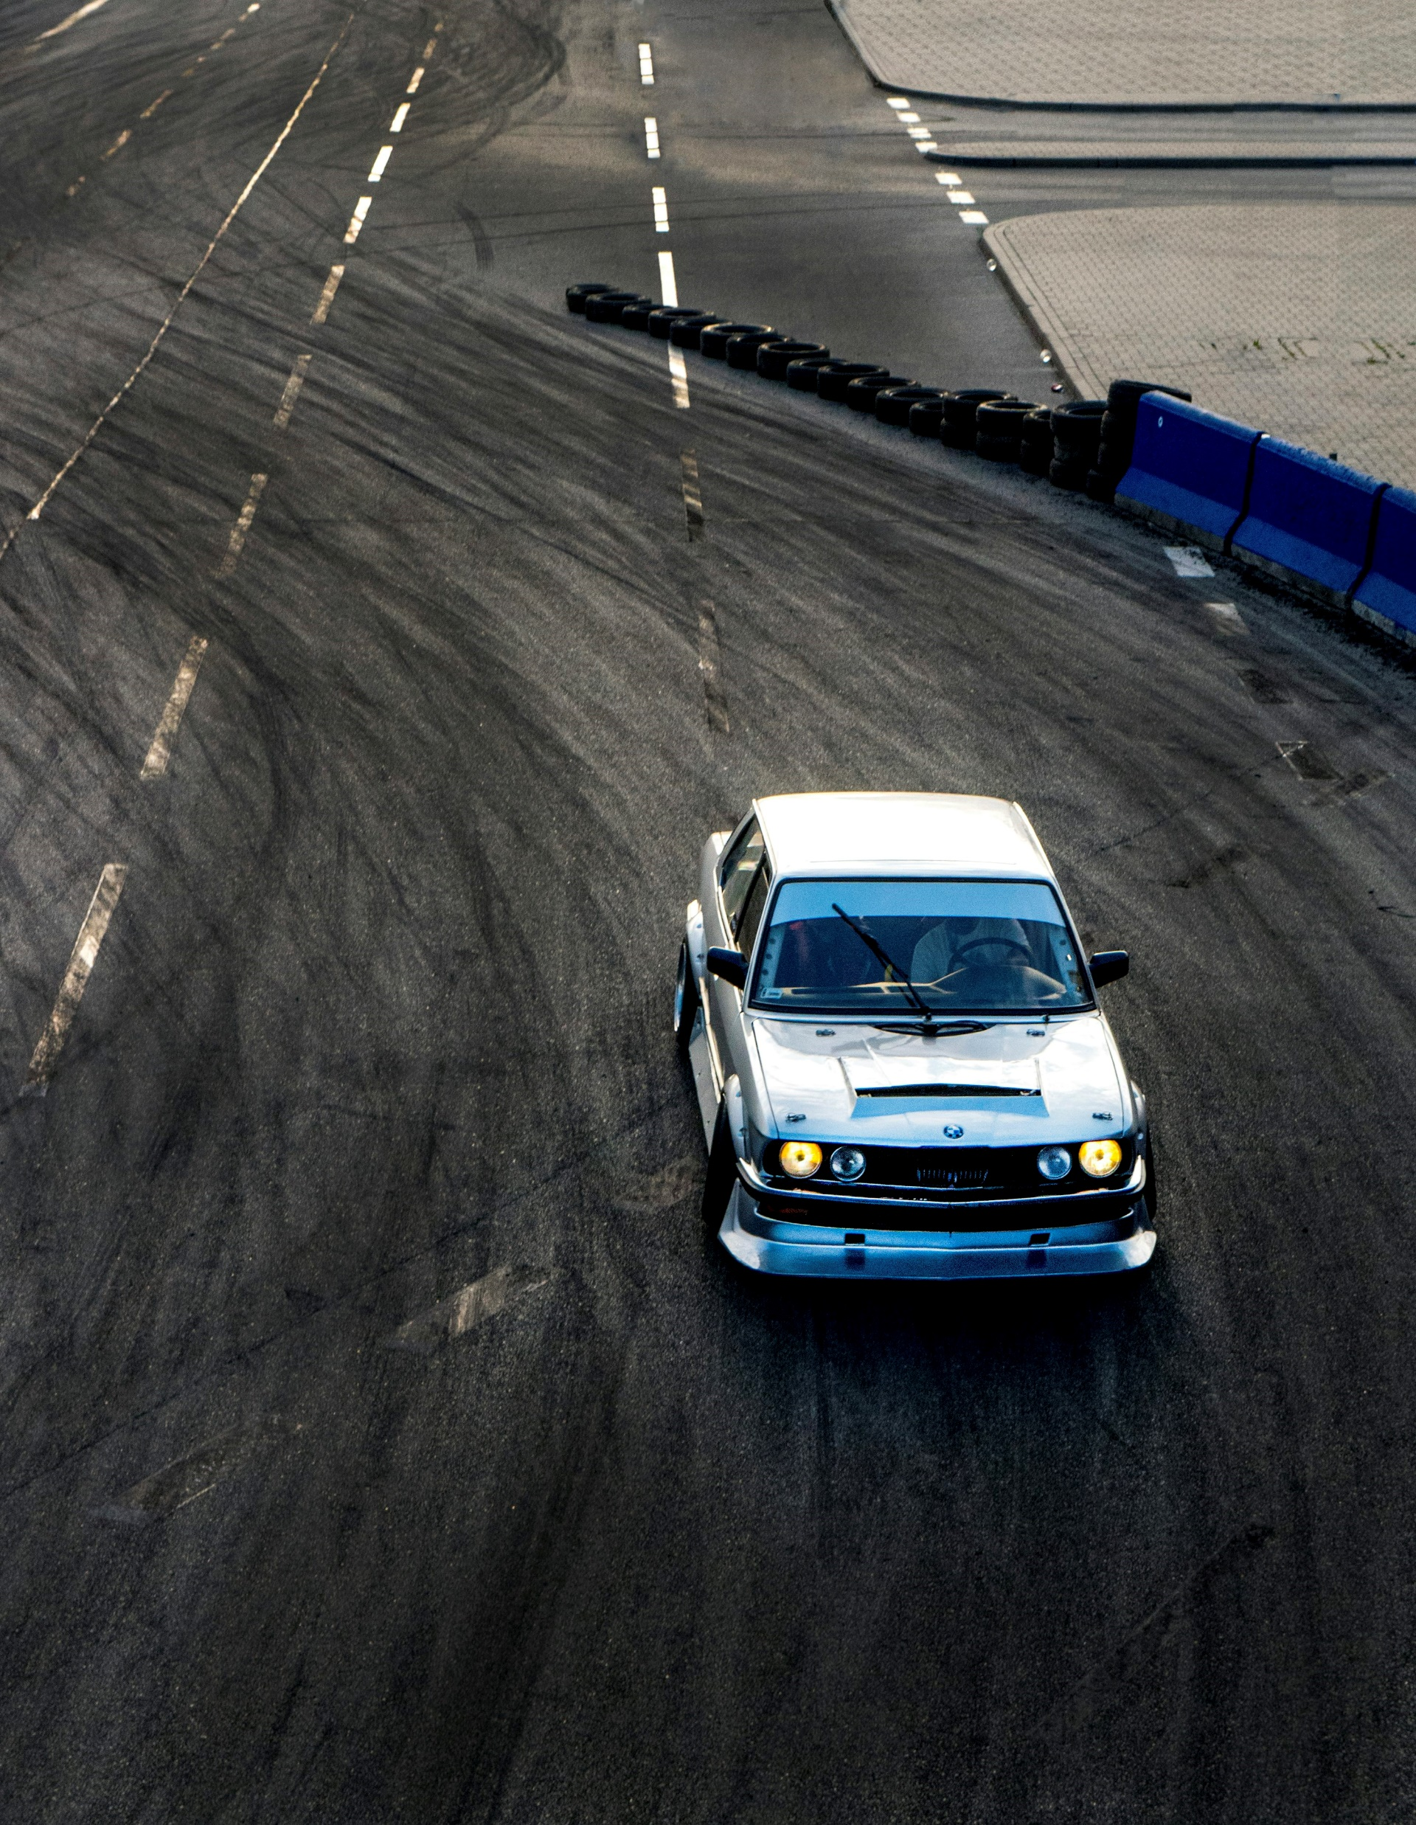
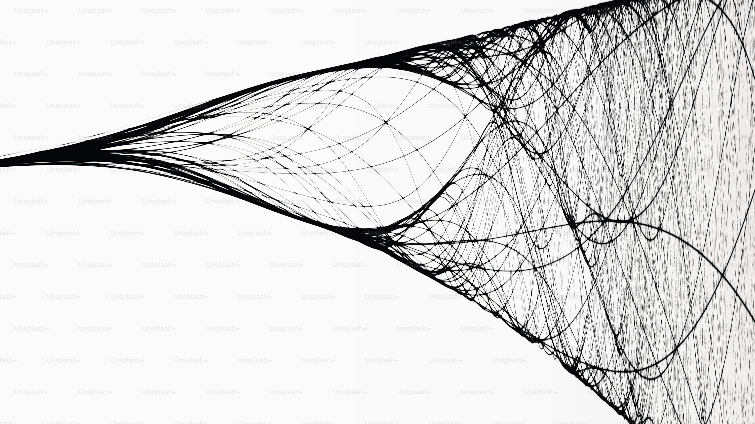
EDA conclusions
Stationary? Yes. With differencing
Autocorrelated? In most cases, No.
Trend? For half the data. (Less than half)
Seasonality. No.
Solutions?
ARIMA – Too few points
Exponential Smoothing
Polynomial Regression models
Naïve methods (Drift approach)

Slide 15

Formulating selection strategy

Slide 16
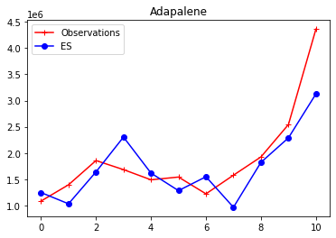
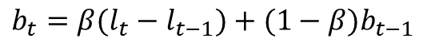
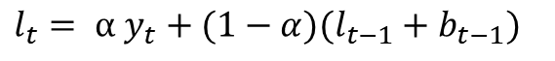
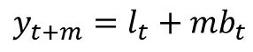
What is Exponential Smoothing?
$l_{t}= α y_{t}+(1−α)(l_{t−1}+b_{t−1})$
Level equation
Forecasting univariate time series
Principle - weighted averages of past observations
Exponentially decreasing weights for past observations
Level and trend equation
Started with simple, but switched to double ES
$b_{t}=β(l_{t}−l_{t−1})+(1−β)b_{t−1}$
Trend equation
$$y_{t+m}=l_{t}+mb_{t}$$
Forecasting equation

Slide 17
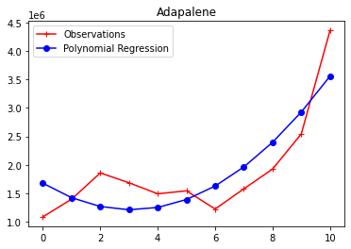
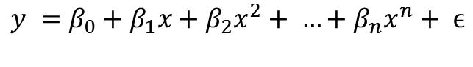
A brief introduction to Polynomial Regression
Extends linear regression by adding extra degrees
Least squares method to find optimal coefficients
Experimented with different degrees
Degree = 3, overfitted
$$y =β_{0}+β_{1}x+β_{2}x^{2}+ …+β_{n}x^{n}+ ϵ$$
Polynomial Regression Equation

Slide 18
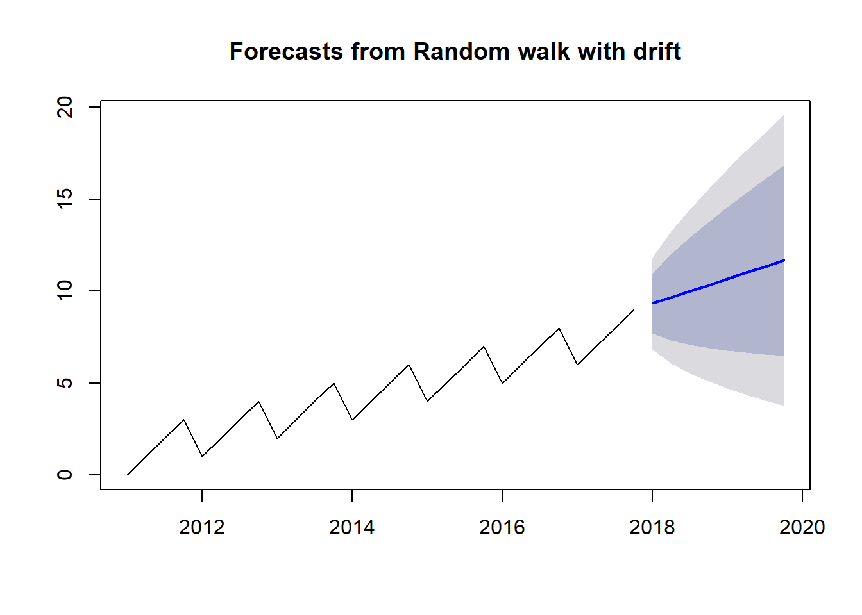
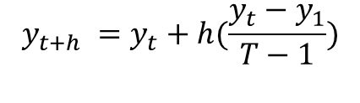
Drift method, a naïve approach to Forecasting
Naïve method = take the last observed value as forecast
Drift allows increasing or decreasing over time
Equivalent to drawing line between the first and last observations
Cannot fit complex curves
$$y_{t+h} =y_{t}+h(\frac{y_{t}−y_{1}}{T−1})$$
Drift Method Equation

Slide 19
Comparing models with RMSE
Train data – Till 2021
Test data – 2022
RMSE generated over all time series
Median value considered
Drift working best, even though the simplest
 | ETS | Drift | Poly
Total Spend | 335431.23 | 210888.80 | 442128.68
Average spend per dosage unit | 0.46 | 0.36 | 0.60
Average spend per claim | 26.37 | 19.63 | 34.98
Average spend per beneficiary | 102.76 | 69.51 | 139.40
For drugs with data only in 2022
Fit Linear Regression model on YoY growth on aggregated features and used that to generate the forecasts

Slide 20
Most likely drugs to be selected
Total expenditure is the focus
Weighted Average of the model forecasts
Total Spending used to decide the rankings
10 drugs for 2026, 15 for 2027 and so on
Year 2026
Eliquis
Jardiance
Trelegy Ellipta
Xarelto
Entresto
Januvia
Farxiga
Imbruvica
Xtandi
Ozempic
Year 2027
Biktarvy
Rybelsus
Brukinsa
Vyndamax
Rinvoq
Ubrelvy
Ingrezza
Calquence
Erleada
Ibrance
Ofev
Austedo
Pomalyst
Nubeqa
Dovato

Slide 21
Most likely drugs to be selected
Year 2030
Lubiprostone
Livtencity
Etravirine
Tepmetko
Amondys-45
Verquvo
Empaveli
Tavneos
Ponvory
Deferiprone
Jatenzo
Bafiertam
Arformoterol Tartrate
Truseltiq
Caplyta
Norgesic Forte
Rukobia
Onureg
Tabrecta
Gimoti
Year 2031
Paxlovid (Eua)
Tyrvaya
Lupkynis
Exkivity
Qelbree
Klisyri
Dojolvi
Trikafta
Loreev XR
Myfembree
Winlevi
Trijardy XR
Vuity
Retevmo
Diacomit
Zeposia
Kloxxado
Nexlizet
Qinlock
Thalitone
Year 2028
Breztri Aerosphere
Nurtec ODT
Sutab
Xywav
Ferriprox
Evrysdi
Erleada
Gavreto
Nubeqa
Calquence
Dovato
Xcopri
Eysuvis
Tukysa
Inqovi
Year 2029
Gemtesa
Orgovyx
Varenicline Tartrate
Lumakras
Rezurock
Cabenuva
Kerendia
Fotivda
Scemblix
Qulipta
Invega Hafyera
Lybalvi
Welireg
Opzelura
Orladeyo

Slide 22

Conclusion

Slide 23

Conclusion
Brand Names were run against FDA Orange Book.
Things I could have tried and explored:
Explore Vector based time series
Intermittent time series
Better analysis of the models
External data sources

